Slide 1



CoCloud : Enabling Efficient Cross-Cloud File Collaboration based on Inefficient Web APIs
Jinlong E, Tsinghua University
Yong Cui, Tsinghua University
Peng Wang, Carnegie Mellon University
Zhenhua Li, Tsinghua University
Chaokun Zhang Tsinghua University
May 2nd, 2017

Slide 2
Outline
① Background & Motivation
② CoCloud Design
③ Implementation & Evaluation
④ Summary of Contributions

Slide 3
Outline
① Background & Motivation
② CoCloud Design
③ Implementation & Evaluation
④ Summary of Contributions

Slide 4

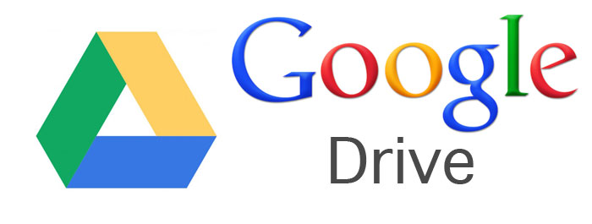




Tremendous Popularity
Over 400M users
10M users in its first two months
4% Internet traffic
Over 200M users
…
Over 14 PB data

Slide 5





Cloud Storage Services
Automatic data backup
Cross-device file sync
Multi-user file collaboration
Create Delete Modify

Slide 6
File Collaboration
“Walled Garden”
Only happens inside each cloud ?!
Users’ preferences for clouds are different for technical and non-technical reasons
▪ Spatial/temporal variations
▪ Unavailable in regions
▪ Personal habits
▪ Cloud characteristics
Can we enable file collaboration across heterogeneous clouds?

Slide 7
Approach I: Manual Sharing
An intuitive approach to collaboratively edit a paper is sharing file URL and issuing HTTP GET request
Inconvenient & inefficient, and hardly adopted in the presence of frequent file edits

Slide 8

Approach II: Full-file Forwarding
Data access at full-file level with cloud RESTful web APIs
Backup Service | File Size and Type
 | 30-KB Document | 10.1-MB Installer
Dropbox to OneDrive | 1min35s | 8min42s
Dropbox to Google Drive | 2min9s | 9min54s
Extremely long forwarding time hardly satisfy timeliness requirement of most file collaborations

Slide 9

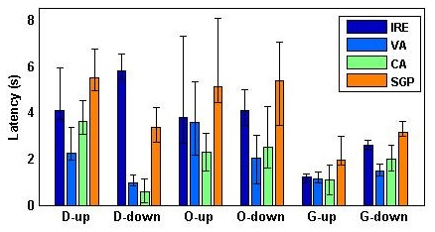

API Measurement & Observation
Some nodes greatly outperform others on latency to a cloud, and show narrow temporal fluctuation
Latency of upload and download with web APIs from AWS nodes
1
+ Other VPS measurement
& Route paths analysis
For each popular cloud, we are always able to deploy one or several nearby proxies which can efficiently access the web APIs

Slide 10
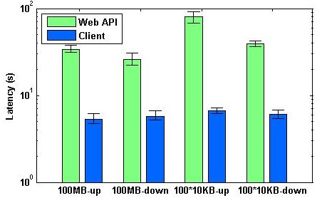
API Measurement & Observation
Latency of Dropbox API and client upload and download (a large file with little modified, a batch of small files)
There is a remarkable latency gap between web API and native client
2
+ A large proportion of files can be compressed and deduplicated
We can adopt capabilities in clients and exploit similar traits among different file versions, to reduce data traffic and shorten sync time

Slide 11
Outline
① Background & Motivation
② CoCloud Design
③ Implementation & Evaluation
④ Summary of Contributions

Slide 12


File Collaboration with CoCloud
Objective: To achieve sound user-perceived performance for cross-cloud file collaboration
▪ Deploy a series of proxies close to the clouds involved
▪ Devise an inter-proxy advanced transfer protocol to integrate data sync techniques (deduplication, compression, bundling)
▪ Design control mechanisms to boost collaboration efficiency

Slide 13
System Framework of CoCloud
CoCloud fulfills file collaboration based on interaction among Client, Control Server, Cloud Proxy
Interact with nearby cloud by web APIs and with peer proxies by the protocol
Authorize users;
Monitor and notify file updates
Handle update notifications by selecting proxies for file transfer

Slide 14

Cloud Proxy Deployment Scheme
Proxy-per-cloud network architecture: one or several proxies are deployed nearby each cloud for efficient data access
$$According to$$
$$Observation I$$
Centralized Cloud
(Cloud service with centralized servers)
 Deploy the source and destination proxies with stably low upload and download transfer latency respectively
Multi-node Cloud
(Cloud service adopting multiple edge nodes)
 Obtain cloud nodes by DNS resolution, and periodically pick out cloud proxies with top download and upload bandwidth to cloud nodes from geo-distributed proxy set

Slide 15

Inter-Proxy Transfer Optimization
Inter-proxy advanced transfer protocol: integrate advanced data sync mechanisms  adaptively-chunked deduplication
 wisely-adjusted compression
 multi-level bundling
$$According to$$
$$Observation II$$
Adaptively-Chunked Deduplication
(Deduplication: transmitting only modified parts to save network bandwidth, especially for large files)
▪ Pre-designated chunk size of rsync algorithm it not the best
▪ Deduplication ratio (eliminated parts / original file) is determined by file content (size, type…) and in-used chunk size
 Predict the optimal chunk size (consistent among file versions)
 Adjust the chunk size for next time locally with typical chunk sizes in idle time of destination proxy

Slide 16
Inter-Proxy Transfer Optimization
Wisely-Adjusted Compression
(Compression: using algorithms like gzip, bzip2, zlib, to reduce traffic overhead at different levels)
▪ Compression ratio (size before compr. / size after compr.) is determined by compression algorithm and file structure
 Compression algorithms are selected based on historic ratios
 Deduplication and compression scheme is decided by comparison of relative computation and transfer rate
 A persistent connection and asynchronous ACKs are adopted between proxies for all buffered files
 A bundled transfer block is built with as many cached small files as possible
Multi-Level Bundling

Slide 17
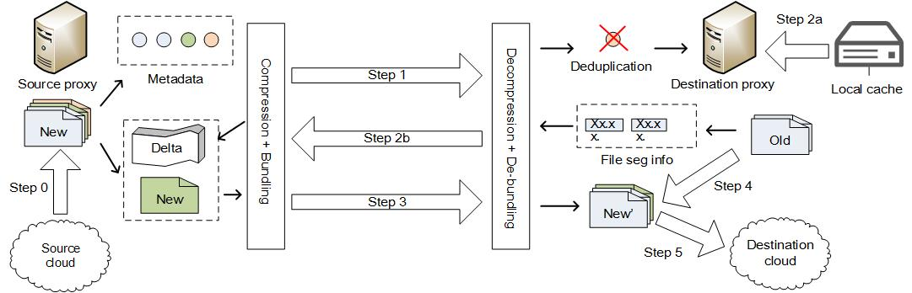
Inter-Proxy Advanced Transfer Protocol
 Step 0: Download updated files from source cloud
 Step 1: Batch and send metadata to compare file version
 Step 2: Adopt the aforementioned optimization schemes
 Step 3: Transfer blocks in a connection with async ACKs
 Step 4: Rebuild the transferred data into files
 Step 5: Upload received files to destination cloud
(Deduplication and compression ratios are predicted in idle time)

Slide 18
File Collaboration Control Mechanisms
▪ Classify file updates by cloud
▪ Schedule proxies with top bandwidth to serve operations
▪ Feed back update status of each file in real time
▪ Notify file updates to server in batch every short period
▪ Eliminate redundant or unnecessary updates locally

Slide 19
Outline
① Background & Motivation
② CoCloud Design
③ Implementation & Evaluation
④ Summary of Contributions

Slide 20

Prototype and Experiment Setup
CoCloud Prototype supports efficient file collaboration among four popular clouds (Dropbox, Google Drive, OneDrive, Baidu PCS) (5000 lines of codes)
Apache MINA framework for proxy-controller interactions
LRU scheme for periodical cached file recycling
OAuth 2.0 for user authorization
FileSystemWatcher for file update monitoring
☞ Available at https://github.com/CoCloud/cocloud-demo
$$Platform$$
$$Setup$$
▪ AWS EC2 and Aliyun ECS nodes serve as cloud proxies, (selected based on periodical latency measurement)
▪ Control server is deployed on Aliyun Silicon Valley node (with little latency to all proxies)

Slide 21
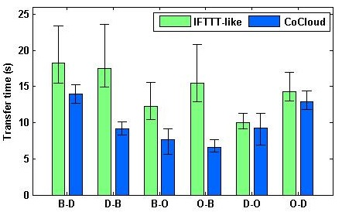
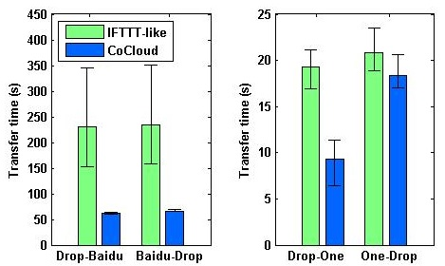
Performance Evaluation
Overall cross-cloud transfer time of 100 *10KB-files and 10 versions of FFmpeg code files (50MB-60MB)
Compare with IFTTT-like forwarding
California EC2 node is used as forwarding proxy (performs best among clouds)
Despite performance disparities among different cloud peers, CoCloud always outperforms IFTTT-like approach (up to 57.4% and 73.1% reduction)

Slide 22
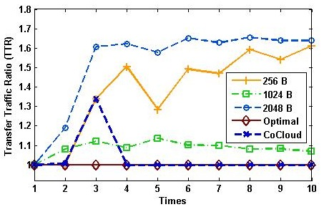
Performance Evaluation
Effectiveness of adaptively-chunked deduplication with TTR among 10 different versions of FFmpeg code files
Transfer Traffic Ratio (TTR) is ratio of traffic of a chunk size to theoretically optimal
CoCloud converges to optimal curve fast and keep steady, outperforming all fixed chunk sizes
-> promote efficiency and robustness of inter-cloud data transfer
Computation time occupy small proportion compared with transfer -> bring little overhead in practice

Slide 23
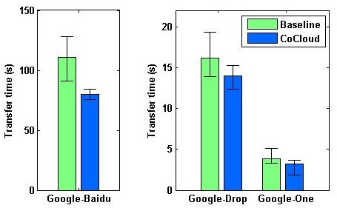
Performance Evaluation
Effectiveness of multi-proxy adoption for Google Drive, by dispatching FFmpeg code files to proxies and measuring transfer time to other clouds
Compare with Baseline scheme
Baseline scheme only adopts only one proxy (California EC2 node)
CoCloud outperforms Baseline for all tests (up to 27.9% reduction)
-> Concurrently utilizing multiple proxies can achieve further efficiency promotion for multi-node clouds

Slide 24
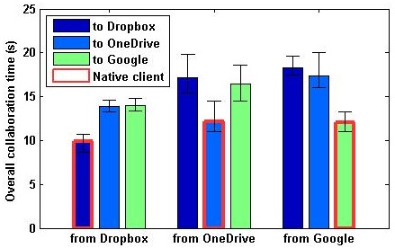
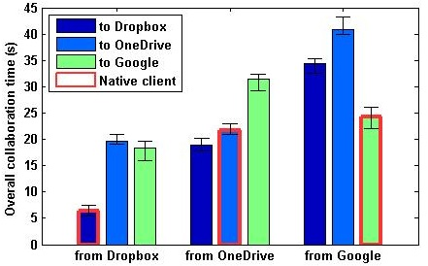
Performance Evaluation
End-to-end collaboration time of a 10-MB Zip file and a batch of doc files (around 10 KB each)
Compare with native collaboration
We simulate scenario that users of popular clouds adopt CoCloud for file collaboration simultaneously
CoCloud takes about 30 seconds on average for the two workloads, achieving the same level of intra-cloud collaboration (1.42x and 1.88x), even outperforming intra-OneDrive collaboration

Slide 25
Outline
① Background & Motivation
② CoCloud Design
③ Implementation & Evaluation
④ Summary of Contributions

Slide 26

■ Summary of Contributions
Goal: Enabling file collaboration across heterogeneous clouds and achieving sound user-perceived performance
1
Two key observations from real-world measurement are drawn to overcome inefficiency of cloud web APIs
We design CoCloud with enabling solutions, including a cloud proxy deployment scheme, an inter-proxy advanced protocol, and file collaboration control mechanisms
2
3
We implement an open-source prototype, and extensive real-world evaluations demonstrate its well acceptable performance for cross-cloud collaboration

Slide 27

The End
Thank you!
Q & A

Slide 28
Related Work
Multiple Cloud Management
▪ Studies control multiple cloud services for redundant data backup ~ DepSky, MetaSync, CYRUS, UniDrive
 CoCloud is an efficient Dropbox-like end-to-end file-level collaboration service among heterogeneous clouds
Cloud Storage Capabilities
▪ Techniques on cloud storage capabilities ~ Rsync, CDC, EndRE, Neptune
 CoCloud overcomes lack of capabilities of web APIs by nearby proxy deployment and inter-proxy transfer protocol
Cloud Service Measurement
▪ Papers measure and benchmark performance of multiple clouds ~ InsideDropbox, TUE, QuickSync
 CoCloud makes comparison between cloud web APIs and native clients, and try to overcome API inefficiency

